Slide 1
NEWS ANALYSIS
23 DECEMBER 2024
BAJIRAO IAS ACADEMY

Slide 2
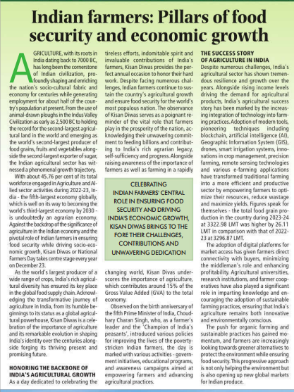
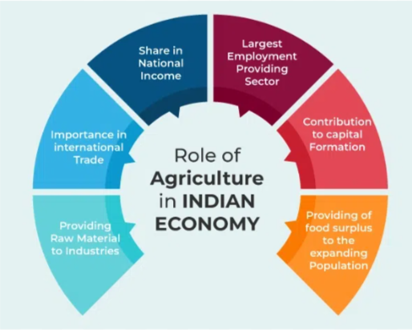
Q)Agriculture is the key to alleviate rural poverty,stop distress migration and most importantly ensure food security,Discuss issues in agriculture secor and measures to overcome issues.

Slide 3
While the 14 volumes of the Dalwai Committee Report on doubling farmers’ income provided a road map for transition from a mere Green Revolution to an Income Revolution for farmers, the country is yet to solve the ‘Riddle of Agriculture distress’.
Agriculture currently contributes justabout 15% to the national output and about 50% of the population directly or indirectly depends on it for employment.
Farmer distress is a real and pressing problem, as evidenced by the protests currently taking place in various parts of the country.
In the past, Government strategy primarily focused on raising agricultural output and improving food security rather than recognising the need to raise farmer’s income.
Low global prices have affected exports and the cheaper imports have hurt domestic prices in the country.
Natural disasters and crop loss leading to impoverishment of rural households

Slide 4
Challenges faced by Agriculture sector
Institutional vis-à-vis Non-Institutional Agricultural Credit:Traditionally, rural agrarian credit needs were met primarily through money-lenders, which led to large scale indebtedness.
Small land holdings: It is fragmented and 87% of farmers are small farmers doing subsistence farming.
Low productivity: Indian farms are smaller (1-2 hectares on average), making it harder to achieve economies of scale.
Low mechanization:It is relatively low and Indian farmers do not utilise many high-yield input varieties used in other agri-producing countries.
High logistics costs:India’s cost of logistics is currently around 14% of GDP – higher than developed country exporters like the US (9.5%).

Slide 5
Precision farming: Evidence is growing about scope of agronomic practices like precision farming to raise production and income of farmers substantially.
Target markets for export: Identify markets with high export potential for competitive value chains and sign beneficial bilateral or multilateral trade agreements with them, raising sanitary and phytosanitary production levels to meet their quality standards and negotiating with them to remove non-tariff barriers.
Solve Value Chain Clusters (VCC) holistically with focus on value addition: The clusters would also serve to converge the government’s spends and schemes, as well as seek any additional funding required, for building the necessary infrastructure .
Promoting research and development and promoting “Brand India” in global markets.

Slide 6
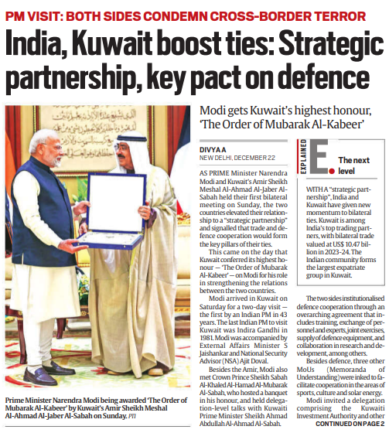
India-Kuwait strategic partnership
During Prime Minister Narendra Modi’s recent visit to Kuwait (first visit by an Indian Prime Minister to Kuwait in 43 years), India and Kuwait elevated their relationship to a "strategic partnership," focusing on key areas like trade, defence, and regional security.

Slide 7
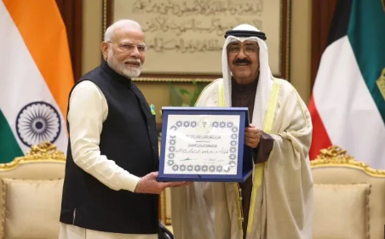
India and Kuwait upgraded their bilateral ties to a strategic partnership, signaling enhanced cooperation in areas like trade, defence, security, infrastructure, and technology.
A key agreement was signed to institutionalize defence ties, including joint exercises, personnel exchanges, supply of defence equipment, and collaboration in research and development.
MoUs Signed: Four Memoranda of Understanding (MoUs) were signed:
Kuwait’s membership of International Solar Alliance (ISA)
Cultural Exchange Programme between India and Kuwait for the years 2025-2029.

Slide 8
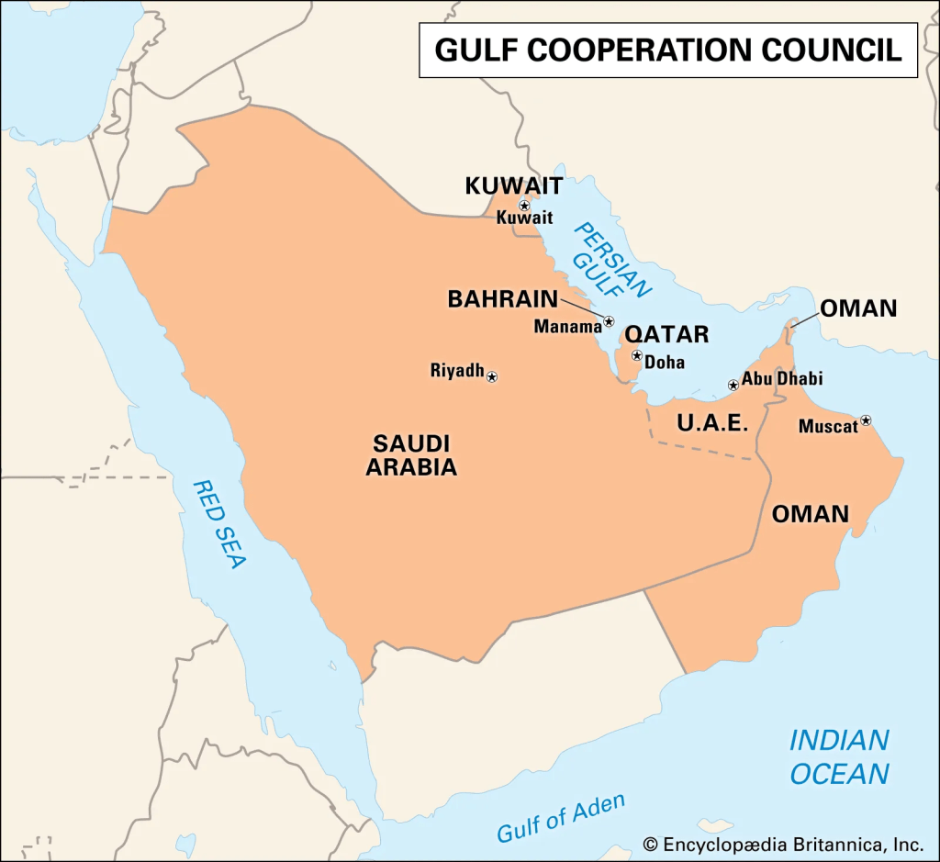
India invited Kuwaiti investors to explore opportunities in sectors like energy, pharmaceuticals, IT, and defence, with the aim to expand bilateral trade, which reached USD 10.47 billion in 2023-24.
Both sides also discussed expediting the India-GCC Free Trade Agreement.
Both nations condemned terrorism in all forms, emphasizing the disruption of terrorism financing and dismantling terror infrastructure. They also stressed cooperation in regional stability, particularly in West Asia.
Vision 2035: Modi expressed India’s commitment to support Kuwait’s "Vision 2035" development plan, which focuses on transforming the country’s economy.
Award: The Amir of Kuwait honored Modi with the prestigious Order of Mubarak Al-Kabeer for his role in strengthening bilateral relations.

Slide 9
Indian rupee fall against US dollar

Slide 10
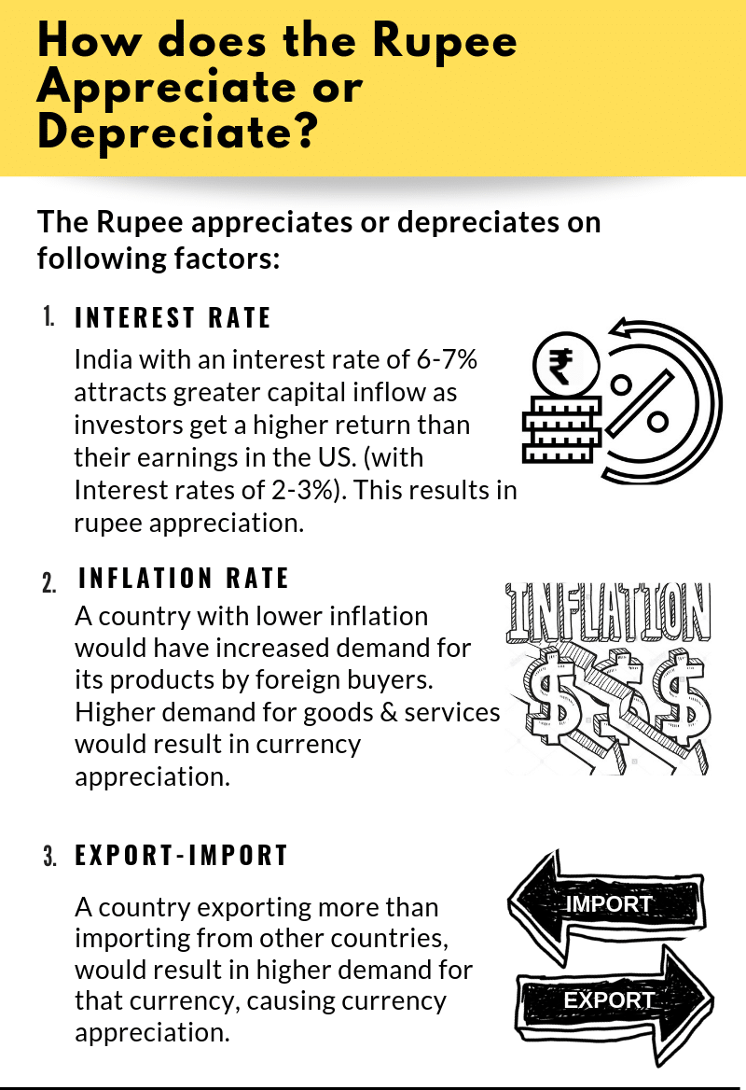
The Indian rupee has weakened against the US dollar, crossing the 85 mark, meaning Rs 85 is needed to buy $1.
In April, the exchange rate was around 83, and a decade ago, it was approximately 61. This reflects a steady decline in the rupee's value relative to the dollar.
Factors Influencing Exchange Rates
Exchange rates are driven by demand and supply dynamics.
If Indians demand more US dollars than Americans demand Indian rupees, the dollar's value rises relative to the rupee, making it costlier.
Persistent demand imbalance strengthens this trend, causing the rupee to weaken against the dollar.

Slide 11
Impact of falling rupee
Negative impact
The most crucial impact would be on inflation as the country imports nearly 80% of its crude oil needs.
This would mean that imports would become costlier and travel through the value chain to raise input costs.
Impact on current account deficit
Since a large proportion of India’s imports are dollar-denominated, these imports will get costlier.
Costlier imports, in turn, will widen the trade deficit as well as the current account deficit, which, in turn, will put pressure on the exchange rate.
Positive impact
One positive impact could be that remittances from overseas could become attractive.
A fall in the rupee can also benefit India's exporters - unless they import raw materials, which would become more expensive.

Slide 12
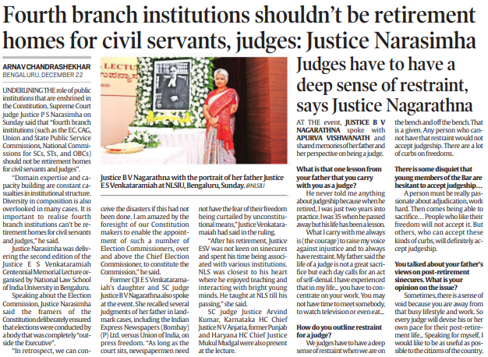
Fourth branch institutions in India
While delivering a speech, Supreme Court judge Justice P S Narasimha said that fourth branch institutions should not be retirement homes for civil servants and judges.
Justice Narasimha was delivering the second edition of the Justice ES Venkataramiah Centennial Memorial Lecture organised by National Law School of India University in Bengaluru.

Slide 13
Fourth Branch Institutions in India
Fourth branch institutions refer to constitutionally or statutorily created bodies that function independently of the executive, legislature, and judiciary to uphold accountability, transparency, and democracy.
These institutions act as watchdogs, ensuring that power is not concentrated in any single branch of government.
E.g., the Election Commission of India (ECI), Comptroller and Auditor General (CAG), Central Information Commission (CIC), and Central Vigilance Commission (CVC) etc.
Concerns
Allegations of partisanship against the ECI during certain elections, such as delayed action on violations of the Model Code of Conduct, raise concerns about its autonomy.
The CAG, too, has faced criticism for delays in audits and alleged overestimation of losses.
Furthermore, institutions like the CIC suffer from vacancies and delays in hearing appeals, reducing their effectiveness.

Slide 14
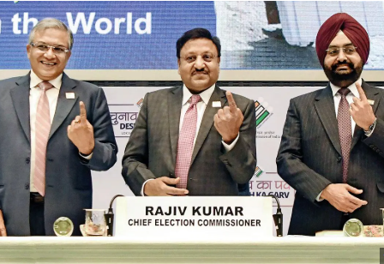
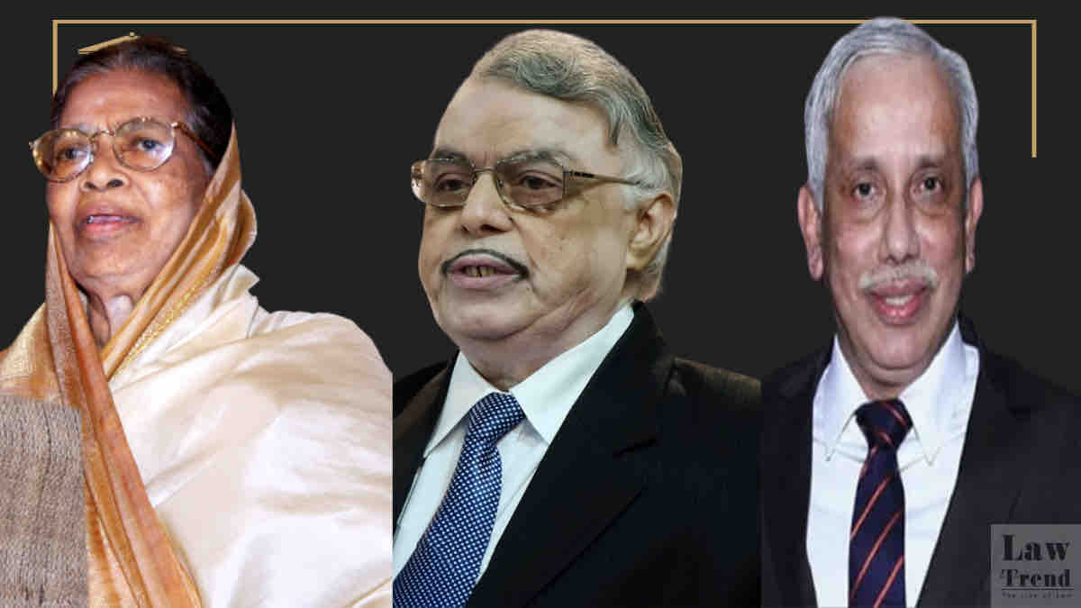
Strengthening these institutions is crucial to safeguard democracy.
Ensuring independence through transparent appointment processes, sufficient funding, and protection from political interference is vital.
Stronger fourth branch institutions will enhance governance, restore public trust, and ensure accountability in a rapidly evolving democratic landscape.

Slide 15
Thank you​
Address​
B-47, Main Road Shivalik Enclave, Block-B, Shivalik Colony, Malviya Nagar, New Delhi-110017​
Phone Number​ +91 8178833167​

